Slide 1

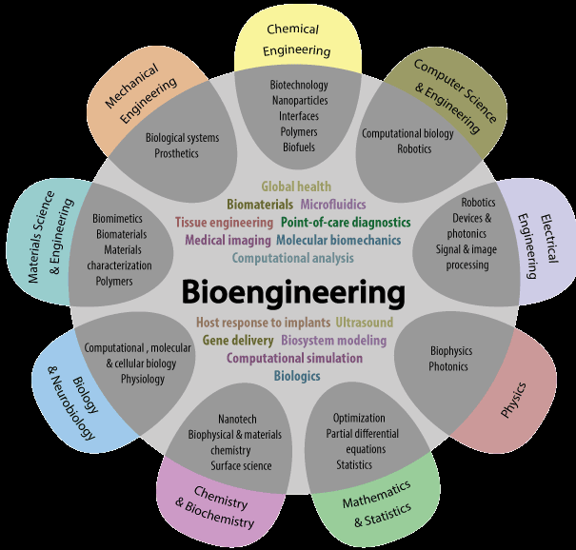
Biology for Engineers: Biomolecules and their applications
Introduction to Biology: About biological molecules
• Biology is a core area of study for engineers, which provides insights into present and future problems with sustainable solutions
• the science of biomimetics has the potential to enrich many areas of technology at present
• Accuracy of biomimetics requires a proper and greater understanding of natural systems
.• Inspired by nature's economical, stable, and sustainable design, evaluating the engineering applications for living systems is critical.

Slide 2
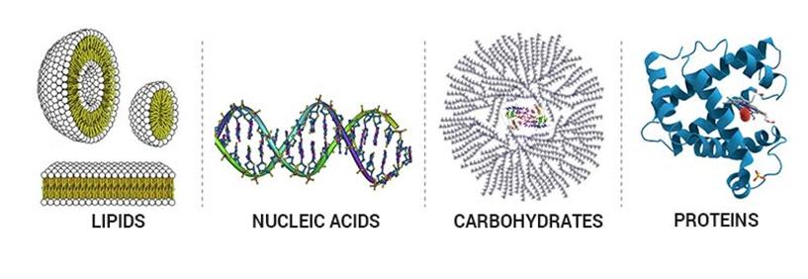
Biology for Engineers
Biomolecules and their applications
Introduction to Biology: About biological molecules
Biomolecules are the most essential in the maintenance and metabolic processes of living organisms.
They range from small molecules such as primary (carbohydrate, nucleic acid, lipids and proteins) and secondary metabolites (antibiotics like penicillin, colored pigments of flowers etc) and hormones to large macromolecules.
Notes:
https://www.youtube.com/watch?v=YO244P1e9QM&ab_channel=AmoebaSisters

Slide 3
Biology for Engineers
Biomolecules and their applications
Introduction to Biology: About biological molecules
Carbohydrates
Biodegradable polymers: packaging materials, medical implants, and drug delivery systems.
Flocculants: commonly used in wastewater treatment, mining, and papermaking industries.
Adhesives: Complex carbohydrates; starch and dextran in papermaking, and construction industry to glue wood and other materials.
Textile industry: Complex carbohydrates such as chitosan can be used in the textile industry as a natural fiber.
Energy storage: Complex carbohydrates such as cellulose can be used in energy storage applications, in the production of super capacitors
Food industry: Starch as a primary source of food and fructose in syrups.
Notes:
https://www.youtube.com/watch?v=YO244P1e9QM&ab_channel=AmoebaSisters

Slide 4
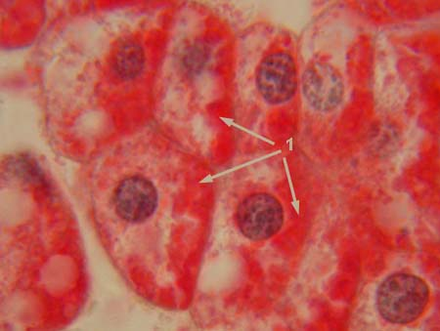
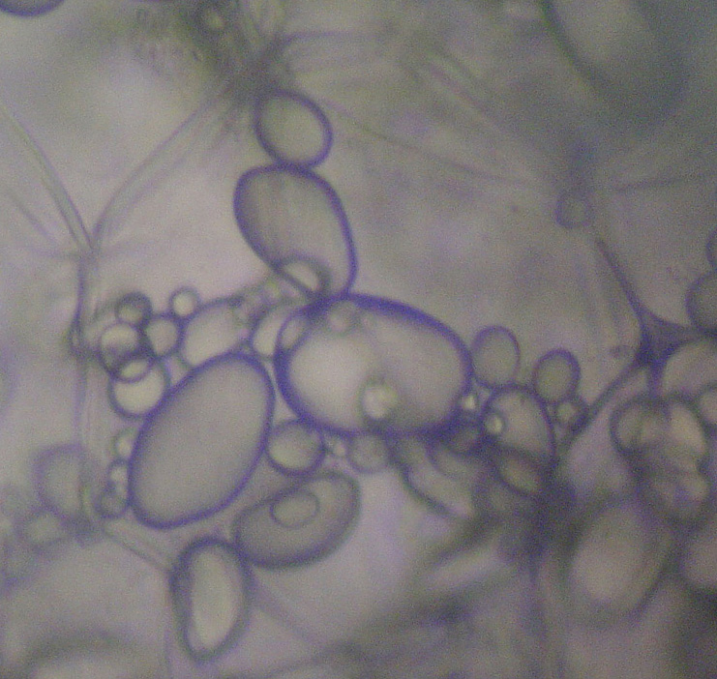
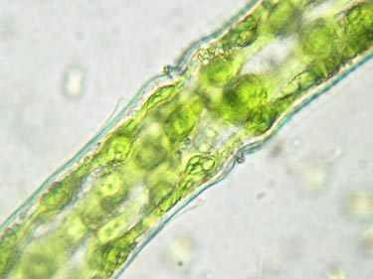
Biology for Engineers
Biomolecules and their applications
Introduction to Biology: About biological molecules
Carbohydrates
Glycogen stored in liver cells (red)
Starch compartments in potato cells
Cellulose in plant cell walls (outer blue layer)
Notes:
https://www.youtube.com/watch?v=YO244P1e9QM&ab_channel=AmoebaSisters

Slide 5
Biology for Engineers
Biomolecules and their applications
Introduction to Biology: About biological molecules
Lipids
Lipids are a diverse group of organic compounds that are not only essential to biological systems but also have important applications in engineering.
Lubricants: such as triglycerides and waxes used in metalworking, textile manufacturing, automobile and papermaking.
Biofuels(biodiesel): Lipids, such as triglycerides and fatty acids, as biofuels which is renewable fuels from plants and algae
Coatings: Lipids, such as phospholipids and sphingolipids, can be used to form coatings on surfaces as protecting against corrosion, usage of vegetable oil in manufacturing of paint etc
Notes:
https://www.youtube.com/watch?v=YO244P1e9QM&ab_channel=AmoebaSisters

Slide 6

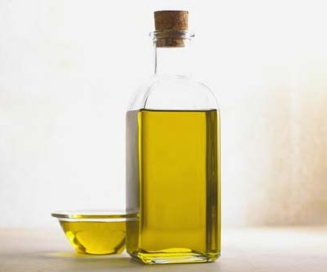
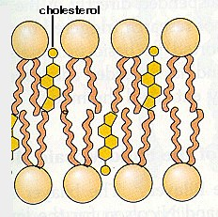
Biology for Engineers
Biomolecules and their applications
Introduction to Biology: About biological molecules
Lipids
Waxes
Oils
Steroids
Notes:
https://www.youtube.com/watch?v=YO244P1e9QM&ab_channel=AmoebaSisters

Slide 7
Biology for Engineers
Biomolecules and their applications
Introduction to Biology: About biological molecules
Proteins
Biocatalysis: Proteins; enzymes as biocatalysts in food production, pharmaceuticals, and biofuels.
Biosensors: Proteins, such as antibodies and receptors, can be used to detect and measure biological molecules in medical diagnosis, environmental monitoring, and food safety.
Bioplastics: Proteins, such as casein(milk protein) and soy protein, can be used as a source of bioplastics such as packaging, agriculture, and medicine.
Tissue engineering: Proteins, such as growth factors and extracellular matrix proteins, can be used to promote tissue regeneration and repair.
Notes:
https://www.youtube.com/watch?v=YO244P1e9QM&ab_channel=AmoebaSisters

Slide 8
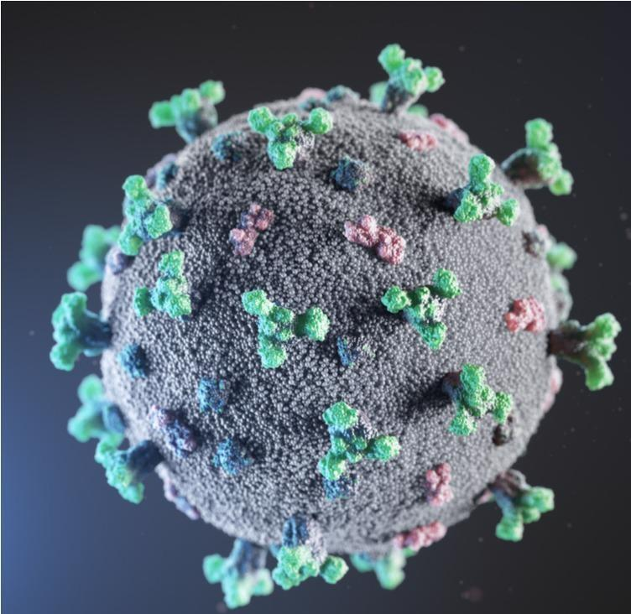
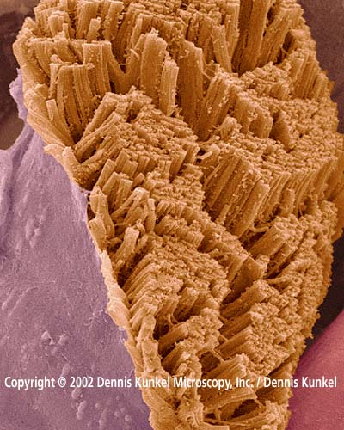
Biology for Engineers
Biomolecules and their applications
Introduction to Biology: About biological molecules
Proteins
SARS-CoV-2 Spike protein
Actin fibers in skeletal muscle cells
. Image Credit: creativeneko/Shutterstock
Notes:
https://www.youtube.com/watch?v=YO244P1e9QM&ab_channel=AmoebaSisters

Slide 9
Biology for Engineers
Biomolecules and their applications
Introduction to Biology: About biological molecules
Nucleic Acids
Genomic data analysis: Next Generation Sequencing (NGS) generates vast amounts of genomic data analyzed using computational methods Artificial Intelligence /Machine Learning (AI/ML) models.
Precision medicine: NGS and AI/ML for tailored treatments based on genetic makeup.
Drug response prediction using AI/ML models help clinicians precise treatments.
Machine learning algorithms can be trained on large genomic datasets to identify patterns and associations between genetic variations and disease outcomes.
Agricultural genomics: NGS and AI-based applications are being used to improve crop yields and disease resistance in agriculture.
Notes:
https://www.youtube.com/watch?v=YO244P1e9QM&ab_channel=AmoebaSisters

Slide 10
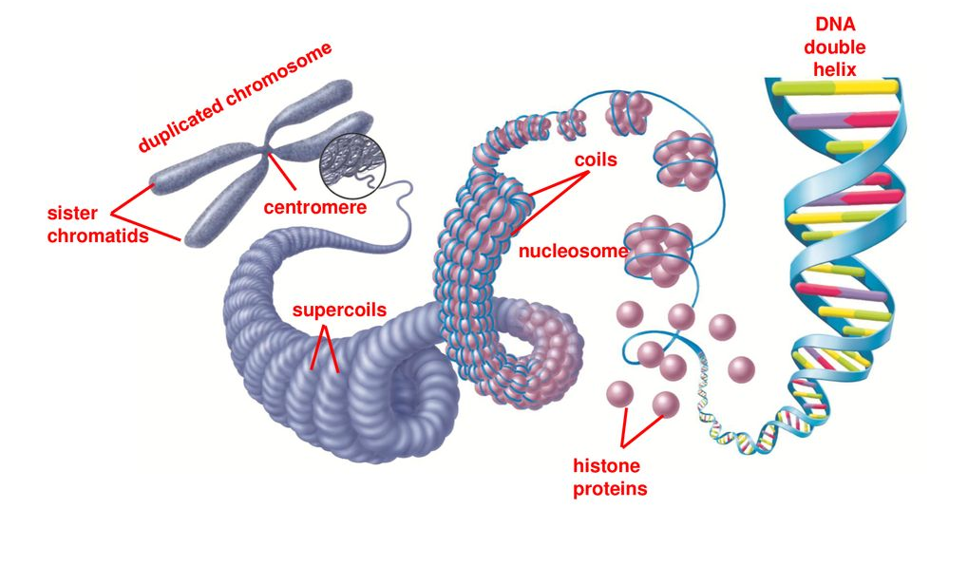
Biology for Engineers
Biomolecules and their applications
Introduction to Biology: About biological molecules
Eukaryotic Chromosome
Notes:
https://www.youtube.com/watch?v=YO244P1e9QM&ab_channel=AmoebaSisters

